Slide 1


CS8811 Project Work Review 3
R.M.K. Engineering College
(An Autonomous Institution)
R.S.M. Nagar, Kavaraipettai-601 206, Gummidipoondi Taluk, Thiruvallur District.
Affiliated to Anna University, Chennai / Approved by AICTE, New Delhi. Accredited by NAAC with A+ Grade / ISO 9001 : 2015 Certified Institution.
All the UG Programs are Accredited by NBA, New Delhi.
Project Title : Enhanced Extraction of Textual Characters from Multimedia using NLP
Team Members
K. DINESH – 111719104044
T. BHARATH – 111719104022
B. SUMANTH – 111719104030
Project Guide
Dr. P. KAVITHA

Slide 2
1. Abstract
Enhanced extraction of textual characters represents a comprehensive framework for detection and recognition of textual content in video frames as well as in images.
Detection of text from document images enables Natural Language Processing algorithms to decipher the text and make sense of what the document conveys.
Furthermore, the text can be easily translated into multiple languages, and summarizes the text in to meaningful phrases using the transformers and pipelines in NLP text summarization. Then converts the summarizer text to an audio using Text-To-Speech library.
NLP, also to recognize text from supermarket product names, traffic signs, and even from billboards, making them an effective translator and interpreter.
The development of this application which will be great help to people with visual impairment and those who don’t know other language.

Slide 3
1.2 Objective
1.1 Problem Statement
The domain has starting with trivial systems recognizing isolated digits and characters to complex end-to-end systems capable of reading text in natural scenes.
This project presents an overview of the notable contributions to detection and recognition of textual content in images and videos.
The objective of OCR is to achieve modification or conversion of any form of text or text-containing documents such as handwritten text, printed or scanned text images, into an editable digital format for deeper and further processing.
The main idea of ​​this project is to select text characters from the running video and summarizes the whole paragraph from an image for easy understanding.

Slide 4
2.1 Review of Literature
S .No. | Title of the Paper | Journal Name | Authors | Year | Methodology | Limitations
1 | Research on Methods of English Text Detection and Recognition Based on Neural Network Detection Model | Hindawi Scientific Programming | Chunlan Li | 2021 | Improved CTPN English Text Detection Algorithm Improved CRNN English Text Recognition Algorithm Algorithm Simulation Test and Result Analysis | it is found that there is a high time complexity and space complexity, which will occupy a large amount of computing resources during detection.
2 | Detection and recognition of cursive text from video frames | Springer | Ali Mirza1*, Ossama Zeshan1, Muhammad Atif1 and Imran Siddiqi | 2020 | a wide range of systems can be developed at the application layer including indexing and retrieval, key-word-based alert generation, and content summarization. | The system will be optimized to work on live streams in addition to archived videos. This will in turn allow development of keyword based alert generation systems.
3 | Text Detection from Scene Videos having Blurriness and Text of Different Sizes | IEEE Transaction on Machine learning | Mayuri A. Mehta Saloni A. Pote | 2018 | In this text detection technique consists of four major steps: pre-processing, text localization, text line formation and text identification. | In this work, they can’t be extended considering videos containing text of different orientations and languages.
4 | Arbitrarily-oriented multi-lingual text detection in video | Springer | Vijeta Khare 1 & Palaiahnakote Shivakumara2,3 & Raveendran Paramesran1 & Michael Blumenstein4 | 2016 | They explore the moments to estimate deviation between temporal frames to separate caption from scene text and background pixels. | The performance of the proposed approach may degrade for arbitrary text movements because it expects constant velocity for text detection in this work

Slide 5
S .No. | Title of the Paper | Journal Name | Authors | Year | Methodology | Limitations
5 | Video Text Detection with Text Edges and Convolutional Neural Network | IEEE Transaction on Machine learning | Ping Hu, Weiqiang Wang, Ke Lu | 2015 | The proposed method comprises two phases: the coarse candidate regions detection and the fine CNN text line localization. | The result show that our method is capable of handling a wide range of videos robustly.
6 | A robust arbitrary text detection system for natural scene images | Elsevier | Anhar Risnumawan a , Palaiahankote Shivakumara a, Chee Seng Chan a , Chew Lim Tan b | 2014 | It is also observed that the Sobel operator gives few pixels for the background while the Canny operator gives a lot of edges with different patterns for the same background. | This is followed by false positive elimination based on some heuristics. The experimental results on ICDAR and MSRA-TD500 data show that the proposed method outperforms the existing methods in terms of precision and F-measure.
7 | A Video Text Detection and Tracking System | IEEE International Symposium on Multimedia | Tuoerhongjiang Yusufu1 ,Yiqing Wang1 , Xiangzhong Fang | 2013 | In this paper we mainly discuss text detection, localization, tracking methods for video text. Using text tracking result background subtraction and text enhancement can be performed in a very simple way. | The proposed scheme does not work well when texts are in complex non-linear motion, such as zooming in/out, rotation and free movement of scene text
8 | Multioriented Video Scene Text Detection Through Bayesian Classification and Boundary Growing | IEEE TRANSACTIONS ON CIRCUITS AND SYSTEMS FOR VIDEO TECHNOLOGY | Palaiahnakote Shivakumara, Rushi Padhuman Sreedhar, Trung Quy Phan, Shijian Lu, and Chew Lim Tan | 2012 | In this paper, we proposed a new video scene text detection method that made use of a new enhancement method using Laplacian and Sobel operations of input images to enhance low contrast text pixels. | Notwithstanding the current limitations that we will deal with in our future research, the contribution of this paper lies in our continued effort in detecting multioriented text lines in videos, which hitherto has not been well explored by others.

Slide 6
3. Existing System
A Text-to-speech synthesizer is an application that converts text into spoken word, by analysing and processing the text using Natural Language Processing (NLP) and then using Digital Signal Processing (DSP) technology to convert this processed text into synthesized speech representation of the text.
Here, we developed a useful text-to-speech synthesizer in the form of a simple application that converts inputted text into synthesized speech and reads out to the user which can then be saved as an mp3.file.
The development of a text to speech synthesizer will be of great help to people with visual impairment and make making through large volume of text easier.
Disadvantages
They are not summarising the whole paragraph from an image for easy understanding.
Advanced NLP concepts not used.

Slide 7
4. Proposed System
The proposed model is to built an application for video/Image-To-Text-Speech. . It also detect the text when webcam placed in any textual regions.
It is an important for the people with visual impairment. The application is built to read any form of text images in any languages which is then converted to a English text using a translator package in python.
The converted text is summarised into phrases for better understanding the whole meaning in the paragraph using transformers and pipeline Natural language processing.
The summarized text is converted into an audio using Text-To-Speech library of NLP.
It also extracts the text from the running Webcam and the summarizes the text in to meaningful phrases and convert it to an audio format for the people with visual impairment.

Slide 8
5. Hardware and Software Used
5.1 Hardware Used
Processor : Any Processor above 500 MHz.
Ram : 4 GB
Hard Disk : 4 GB
Input device : 4 GB
Output device : VGA and High Resolution
5.2 Software Used
Operating System :Windows 7 or higher
Programming : Python 3.6 and related libraries
Tool : Anaconda with Jupyter Notebook

Slide 9
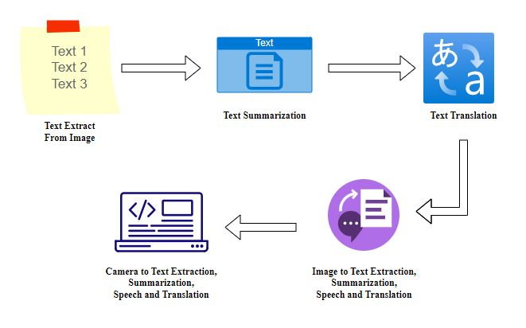
6. Architecture Diagram

Slide 10
7. Methodology
The overall system comprises of three main modules, text detector, script identifier, text recognizer, and Speech Representation.
Text Detection and Recognition :
The first step in the proposed framework is the detection of candidate text regions from the extracted video frames. For detection of textual content in a given frame, we have employed the CRAFT Algorithm for textual regions and used warnings package for ignore the warning.
Summarization Techniques :
Text summarization is a natural language processing (NLP) task that allows users to summarize large amounts of text for quick consumption without losing any important information.
Translation Techniques:
To translate the text from one language to another using Python, we are going to use a package named googletrans that has been called internally to the Google Translate API.
Speech Representation :
The Advanced module for speech conversion is pyttsx3. It is a text-to-speech conversion library in Python. Unlike alternative libraries, it works offline and is compatible with both Python 2 and 3. An application invokes the pyttsx3.init() factory function to get a reference to a pyttsx3. Engine instance. it is a very easy to use tool which converts the entered text into speech.

Slide 11
ALGORITHMS
CRAFT ALGORITHM FOR TEXT DETECTION:
Many deep learning models in computer vision have been used for the scene text detection task over the past few years. However, the performance of these models is not up to the mark when the text in the image is skewed or curved. The CRAFT(Computerized Relative Allocation of Facilities Technique) model performs well on even curved, long and deformed texts in addition to normal text. The CRAFT text detection model uses a convolutional neural network model to calculate region scores and affinity scores. CRAFT text detection model works well at various scales, from large to small text and is shown to be effective on unseen datasets as well .

Slide 12
CRNN ALGORITHM FOR TEXT RECOGNITION:
After the text detection step, regions, where the text is present, are cropped and sent through convolutional layers to get the features from the image. Later these features are fed to many-to-many LSTM architecture, which outputs soft max probabilities over the vocabulary. These outputs from different time steps are fed to the CTC decoder to finally get the raw text from images. One can relate this to training any LSTM model with word embeddings like word2vec, Glove, fast Text. In the modelling, we are making a sequential model. The first layer of the model is the embedding layer which uses the 32 length vector, and the next layer is the LSTM layer which has 100 neurons which will work as the memory unit of the model. After LSTM, the dense layer which is an output layer with sigmoid function, sigmoid function helps in providing the labels.

Slide 13
NegEX ALGORITHM FOR SUMMARIZATION:
The NegEx algorithm relies on four types of lexical cues: negation triggers that indicate a negation (e.g., “denies”), pseudo-negation triggers that contain negation triggers but do not negate the clinical condition (e.g., “no increase”), and termination terms that stop the scope of the negation trigger (e.g., “but”). Any clinical condition within the scope of a negation trigger is negated. All NegEx lexical items have an action—negation and pseudo-negation triggers can modify information to the right of the term (i.e., forward in the sentence) or to the left of the term (i.e., backward in the sentence). Termination terms have an action to terminate scope, which otherwise terminates at the end of the sentence. Pseudo negation triggers attempt to compensate for NegEx’s lack of syntax by listing exceptions to the occurrence of negation triggers such as “no” in phrases like “no previous”. Because the lexicon is the keystone of the algorithm, adaptation of Neg Ex to other languages relies mainly on translation of the lexical cues.

Slide 14
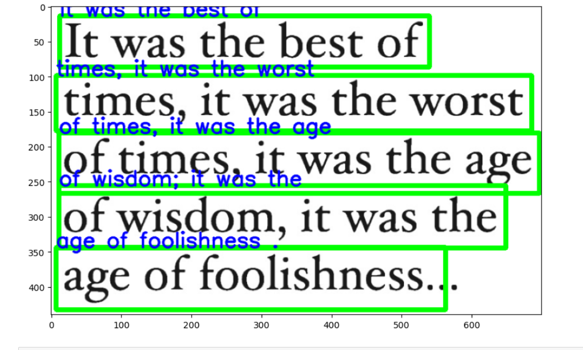
Image to Text Detection
8. Experimental Results

Slide 15
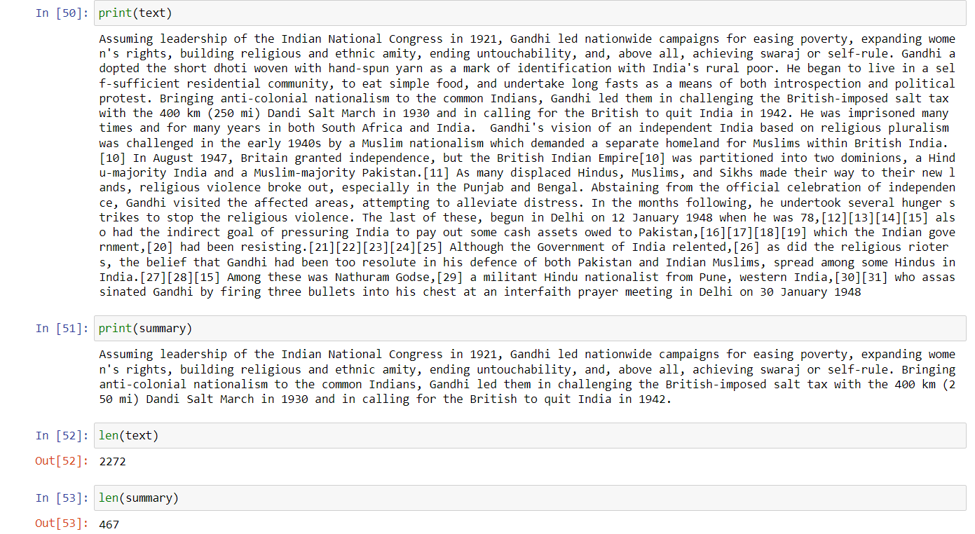
Summarization

Slide 16
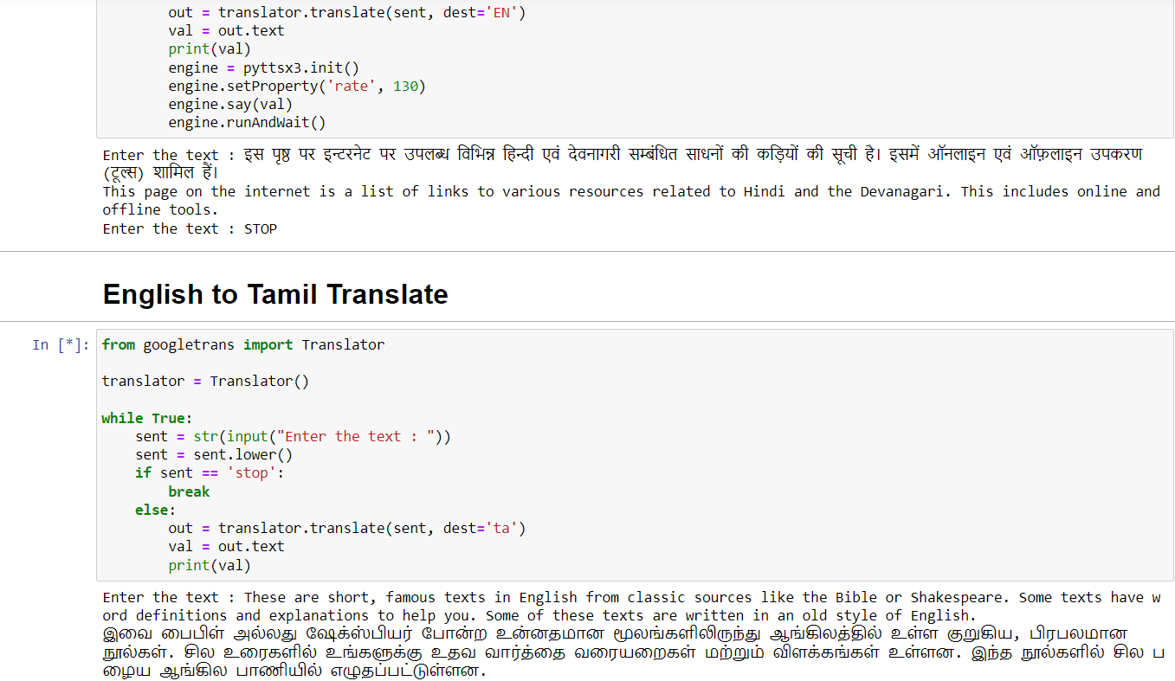
Translation

Slide 17
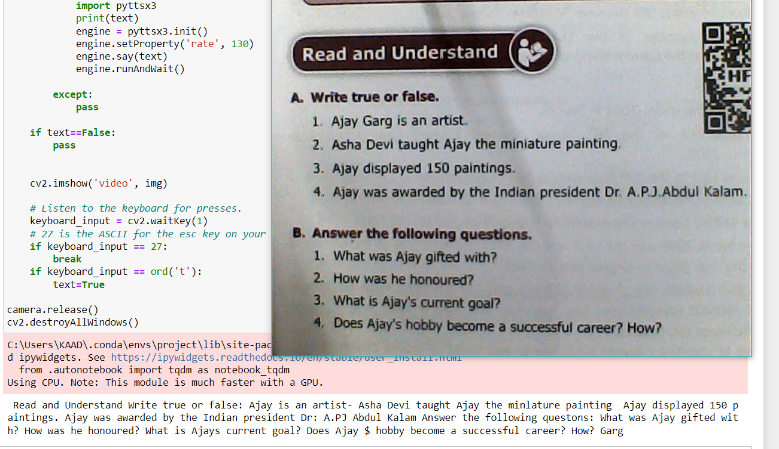
Webcam to Text Detection

Slide 18
9. Expected Results
By this project, we have investigated methods in building an efficient way of detecting and recognizing text in camera frames. It increases the efficiency of the Webcam and also reduces the working time in copy data items.
We are implementing Language translation while reading the image which is faster than translating the extracted text.
Implementation of summarising the text is helpful in understand the whole context of the text or paragraph.

Slide 19
10. References
A. Coates, B. Carpenter, C. Case, S. Satheesh, B. Suresh, T. Wang, D. J. Wu, and A. Y. Ng. Text detection and character recognition in scene images with unsupervised feature learning. In ICDAR, pages 440–445, 2011.
X.-S. Hua, W.-Y. Liu, and H.-J. Zhang. An automatic performance evaluation protocol for video text detection algorithms. IEEE Transactions on Circuits and Systems for Video Technology, 14(4):498–507, 2004.
W. Huang, Y. Qiao, and X. Tang. Robust scene text detection with convolution neural network induced mser trees. In ECCV, pages 497–511. 2014.
X. Huang and H. Ma. Automatic detection and localization of natural scene text in video. In ICPR, pages 3216–3219, 2010.
5. C.-Y. Lee, A. Bhardwaj, W. Di, V. Jagadeesh, and R. Piramuthu. Region-based discriminative feature pooling for scene text recognition. In CVPR, pages 4050–4057, 2014.
6. X. Liu and W. Wang. Extracting captions from videos using temporal feature. In ACMMM, pages 843–846, 2010.
7. Y.-F. Pan, C.-L. Liu, and X. Hou. Fast scene text localization by learning-based filtering and verification. In ICIP, pages 2269–2272, 2010.

